Slide 1
EDA Hotel booking

Slide 2
Present by :
Devganiya Vishesh
Devganiya Jay
guided by :
Abhishek Wavhal

Slide 3
Project Summary
This Project was given to us by the team with an intention to understand the Business done by Hotel Group.
This Dataset had two hotels City Hotel and Resort Hotel.
The data provided was for 3 years 2015 , 2016 and 2017.
we also have the revenue and booking details with number of days of stay and booking cancellation,total number of guests including children.
It also specifies guests wait period for booking , repetation of guests,their food choices among others.
The data also gives us an analysation of countries from which bookings have been done.
We also a agent and other channels who also help in business by booking rooms for guests on the resort and city hotel behalf.
The data is divided between city hotel and resort hotel.
We will also take help of charts for better analysis.

Slide 4
Hence we can make a fair comparison between both.
Before visualize any data from the data set We will do the data cleaning as to fill any null values and delete any duplicated values and after that we have to do data wrangling.
Also we will do our analysis for both city and resort as individual businesses and in comparision to one another.

Slide 5
Problem Statement
This data set contains booking information for a city hotel and a resort hotel, and includes information such as when the booking was made,the number of adults, children, and/or babies, and the number of available parking spaces, which agent made the booking, among other things.
The objective of this project is Explore and analyze the data to discover important factors that govern the bookings.
Analyse and visualize the data on bookings of City Hotel and Resort Hotel to gain insights on the different factors that affect the booking and ADR.

Slide 6
Data overview :
hotel :- Type of hotel(Resort or City).
is_canceld :- If there was booking cancel(0) or not(1).
lead time :- The number of days between time books their room to arrive hotel.
arrival_date_year :- Year of arrival date.
arrival_date_month :- Month of arrival date.
arrival_date_week_number :- Week no. of year for arrival date.
stays_in_weekend_nights :- No. of weekend nights(Saturday or sunday) spend by guest at hotel.stays_in_week_nights :-No. of weeknight( Mon to Fri) spend by guest at hotel.
adults :- No. of adults among guest.
children :- No. of children among guest.
babies :- No. of babies among guest.
meal :- Type of meal booked by guest.
country :- Country of guest.
market_segment :- grouping into categories based on their booking patterns and travel habits.
distribution_channel :- Name of booking distribution channel.

Slide 7
is_repeated_guest :- If the booking was from repeated by guest(1) or not(0).
previous_cancelletions :- No. of previous booking that were cancelled by the customer prior to the customer booking.
previous_booking_not_canceled :- No. of previous booking that were not cancelled by the customer prior to the customer booking.
reserved_room_type :- Code of room type reserved.
assigned_room_type :- code of room type reserved.
booking_changes :- No. of changes made to the booking.
deposit_type :- Type of the deposit made by the guest
agent :- Id of the agent who made the booking.
company :- Id of the company that made the booking.
days_in_waiting_list :- No. of days the booking on the waiting list.
customer_type :- Type of customer, assuming one of four categories.
adr :- (Average Daily Rate) dividing the sum of lodgging transaction by the total number of staying night.
required_car_parking_spaces :- No. of car parking spaces required by the customer.
total_of_special_request :- No. of special request made by the customer.
reservation_request :- Reservation status
reservation_request_date - Date of last reservation status updated.

Slide 8
Data cleaning summary
The given dataset is of Hotel Booking and we have to analyse and explore this dataset to discover important factors which affects the Hotel Booking.
This dataset has 119390 rows and 32 coulumns.
The duplicate value count is 31994 rows..
There are 4 columns in dataset which is having missing valuse and those columns are company, agent, country and children.
There are separate columns called adults, children and babies that show the total number of people who are coming to visit, so instead of different columns will add these three in one called total_num_people
There are separate columns called stays_in_weekend_nights and stays_in_week_nights that show the total stay time people who are coming to stay, so instead of different columns will add these two in one called total_stay

Slide 9
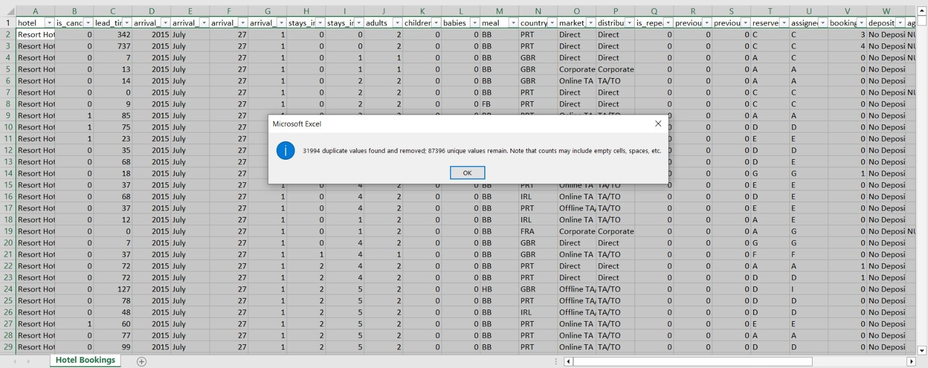
Total Rows are in dataset is 119390
Remove Duplicate From dataset
There are total 31994 duplicate values found
After Remove duplicate Total remain values are 87396

Slide 10
There are 4 columns in dataset which is having missing valuse and those columns are company, agent, country and children
Count of null value in this Columns
Company = 82138
Country = 452
Children = 2
Agent = 12193
Out of these 4 columns the mostly likely null values is in Company column so we delete the entire column.
There were a total of 12193 NULL values in the agent column so we replaced them with other values and we processed the same in country column.
There are only 2 null values in the children column, so we remove those 2 values.

Slide 11
After data cleaning overview
hotel :- Type of hotel(Resort or City).
is_canceld :- If there was booking cancel(0) or not(1).
lead time :- The number of days between time books their room to arrive hotel.
arrival_date_year :- Year of arrival date.
arrival_date_month :- Month of arrival date.
arrival_date_week_number :- Week no. of year for arrival date.
stays_in_weekend_nights :- No. of weekend nights(Saturday or sunday) spend by guest at hotel.
stays_in_week_nights :-No. of weeknight( Mon to Fri) spend by guest at hotel.
adults :- No. of adults among guest.
children :- No. of children among guest.
babies :- No. of babies among guest.
meal :- Type of meal booked by guest.
country :- Country of guest.
market_segment :- grouping into categories based on their booking patterns and travel habits.
distribution_channel :- Name of booking distribution channel.
is_repeated_guest :- If the booking was from repeated by guest(1) or not(0).

Slide 12
previous_cancelletions :- No. of previous booking that were cancelled by the customer prior to the customer booking.
previous_booking_not_canceled :- No. of previous booking that were not cancelled by the customer prior to the customer booking.
reserved_room_type :- Code of room type reserved.
assigned_room_type :- code of room type reserved.
booking_changes :- No. of changes made to the booking.
deposit_type :- Type of the deposit made by the guest
agent :- Id of the agent who made the booking.
company :- Id of the company that made the booking.
days_in_waiting_list :- No. of days the booking on the waiting list.
customer_type :- Type of customer, assuming one of four categories.
adr :- (Average Daily Rate) dividing the sum of lodgging transaction by the total number of staying night.
required_car_parking_spaces :- No. of car parking spaces required by the customer.
total_of_special_request :- No. of special request made by the customer.
reservation_request :- Reservation status
reservation_request_date :- Date of last reservation status updated.
Total_num_people :- sum of three column children,adults,babies
Total_stay - sum of stay_in_weekend_nights and stay_in_week_Nights

Slide 13
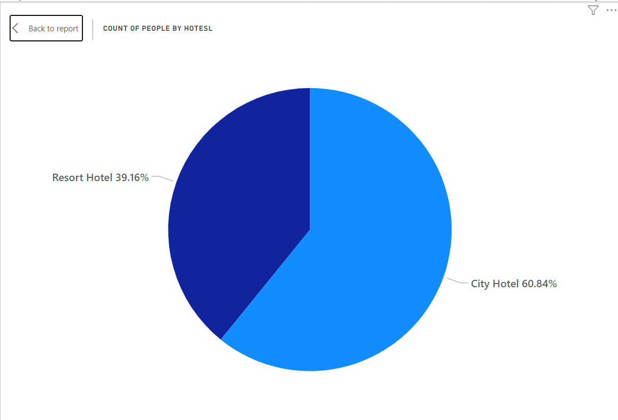
1.Number of peoples book resort hotel and city hotel?
I have made a pie chart because there are not many categories in these questions.
The majority of people, accounting for 60.84%, prefer staying in city hotels, while the remaining 39.16% opt for resort hotels

Slide 14
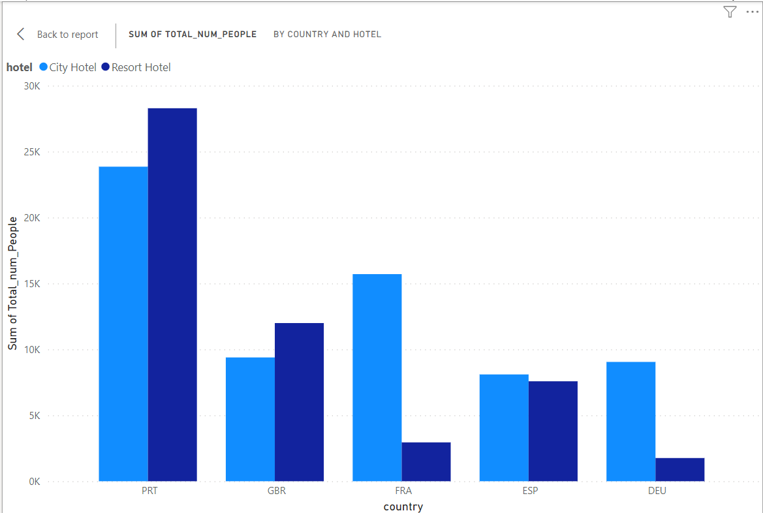
2. from which country we have getting more bookings?
The highest booking is from PRT country
PRT country has made the highest number of booking in resort hotels

Slide 15
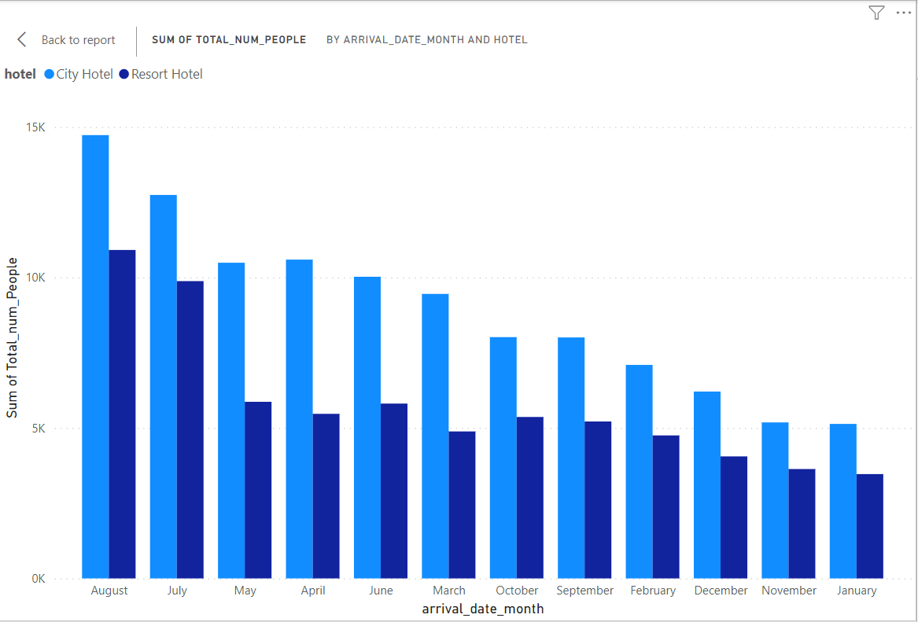
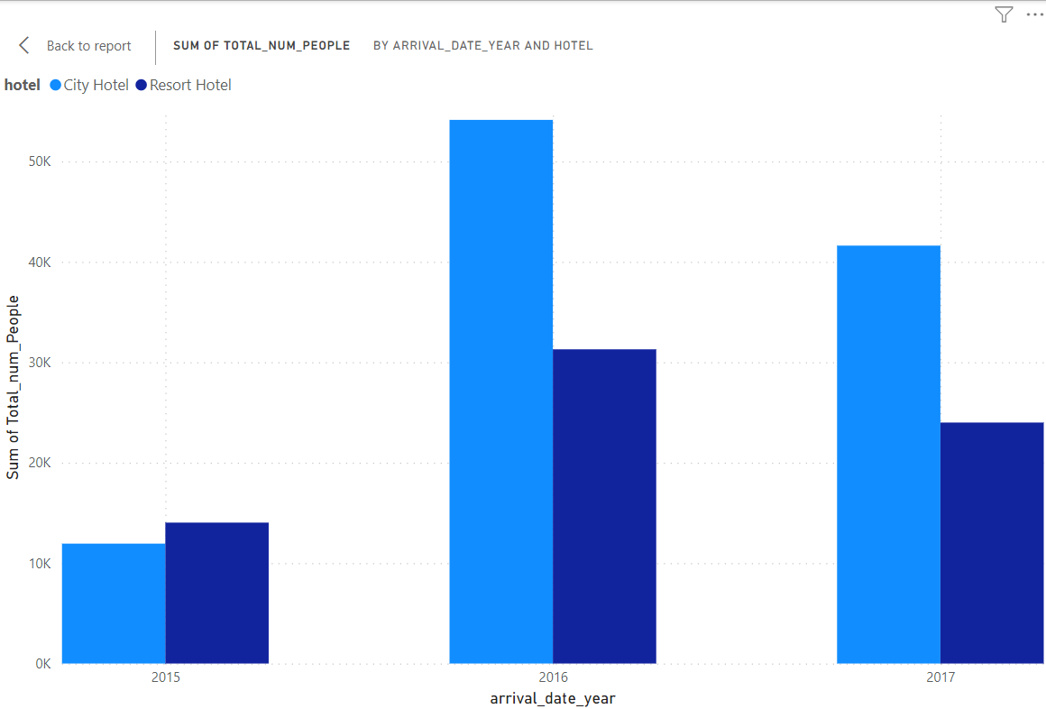
3.in which year or month are more hotels booked ?
Maximum booking have been done in the year 2016 and in the month of August
Lowest booking have been done in the year 2015 and and in the month of January

Slide 16
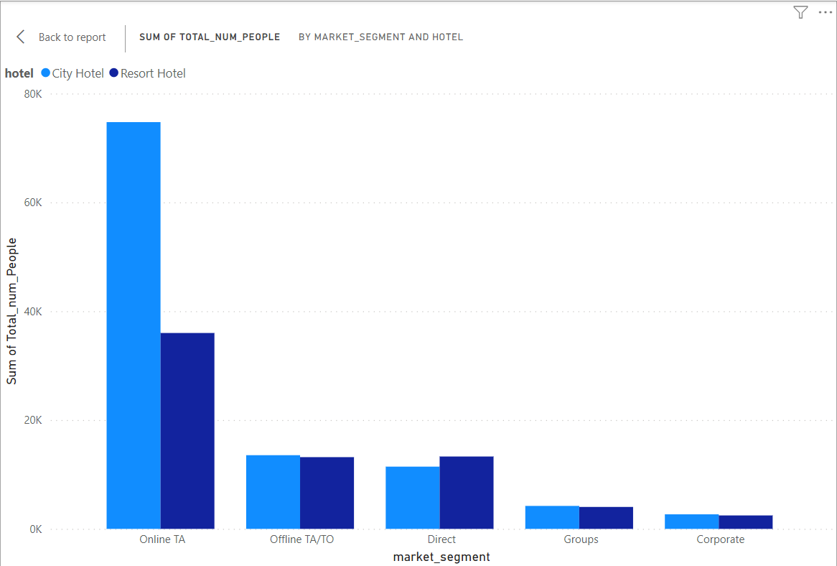
4.from which kind of market we are getting more booking?
Most of Booking in both hotel were done Online TA
Highest booking in City Hotel

Slide 17
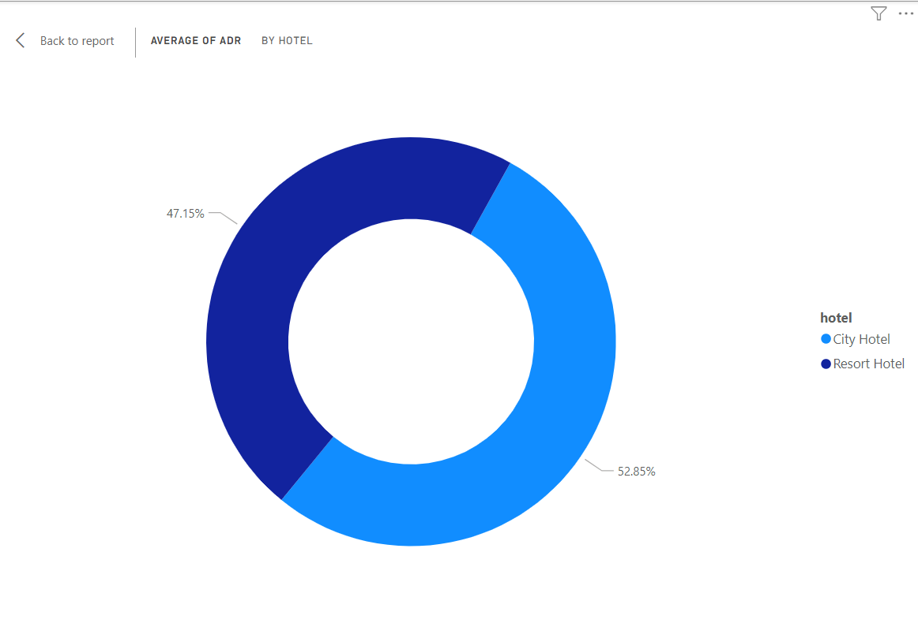
5.which hotel have higher Avg ADR ?
I have made a Dounut chart because there are not many categories in these questions.
City Hotel has the highest rate on the basis od dounut chart

Slide 18
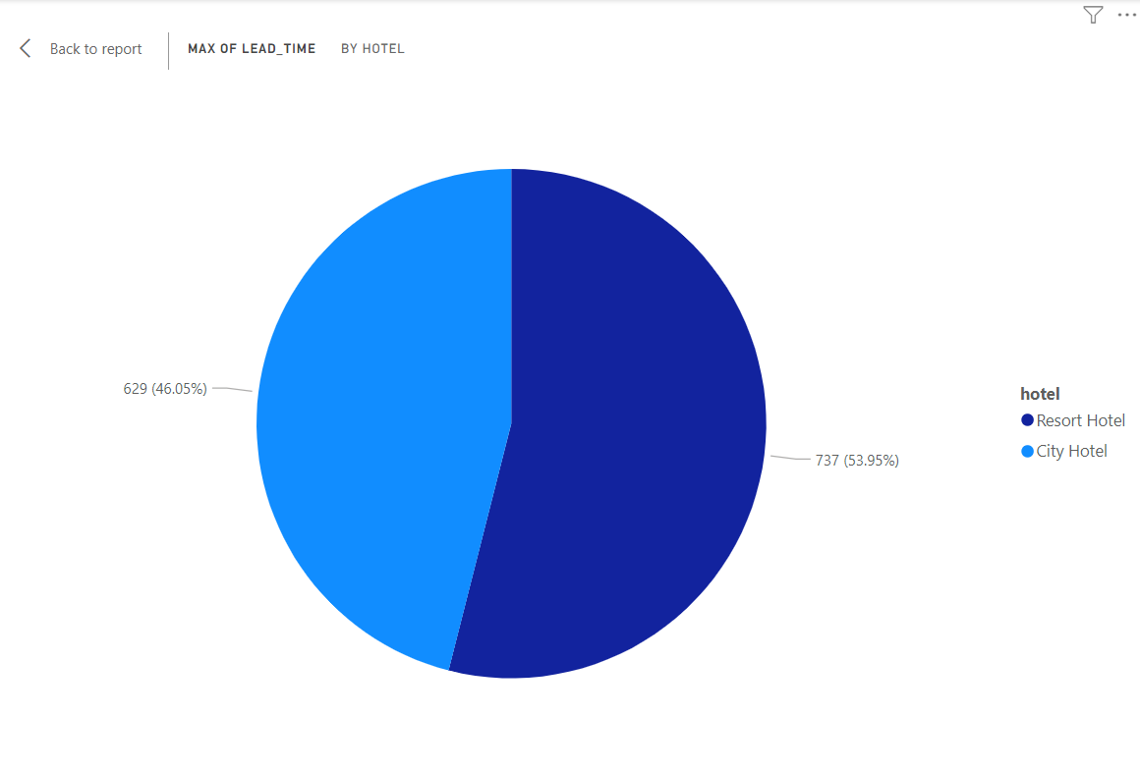
6.which hotel has longer lead_time ?
Resort Hotel have Longer Lead_time based on this pie chart
City hotel owners will have to see what facilities a resort hotel provides due to which the lead time of resort hotel is more then that of city hotels .

Slide 19
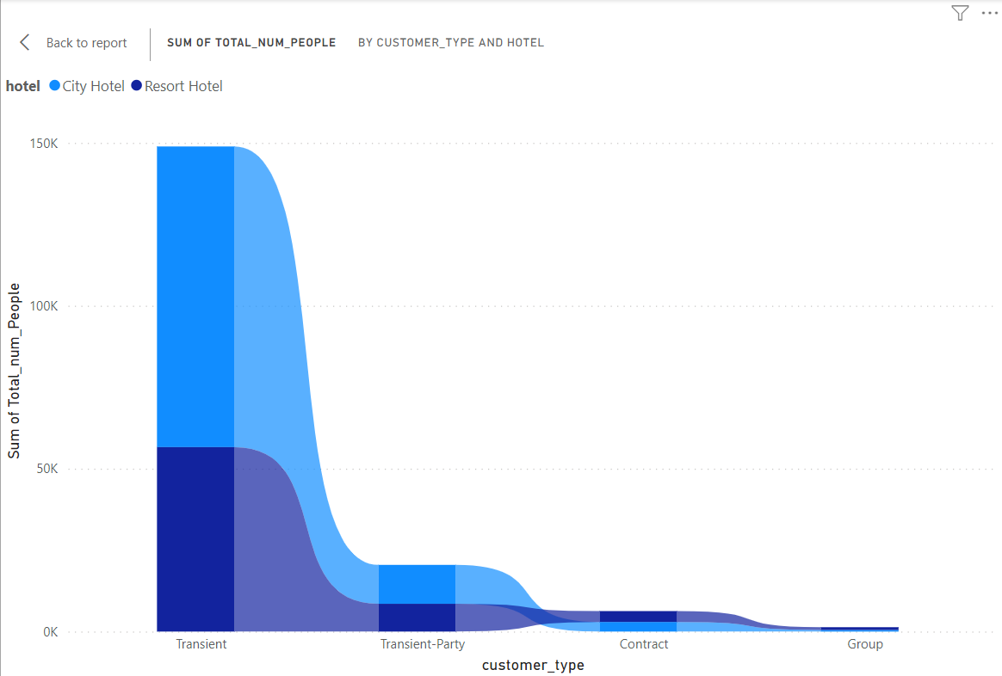
7.which type of customer do you book more ?
It can be seen from the chart that transient type customers book more hotels and group customers book less
What are both the hotels not able to provide that group type customer are booking less?
To solve this problem , what facilities should be provided which will increase group and other types of customer booking

Slide 20
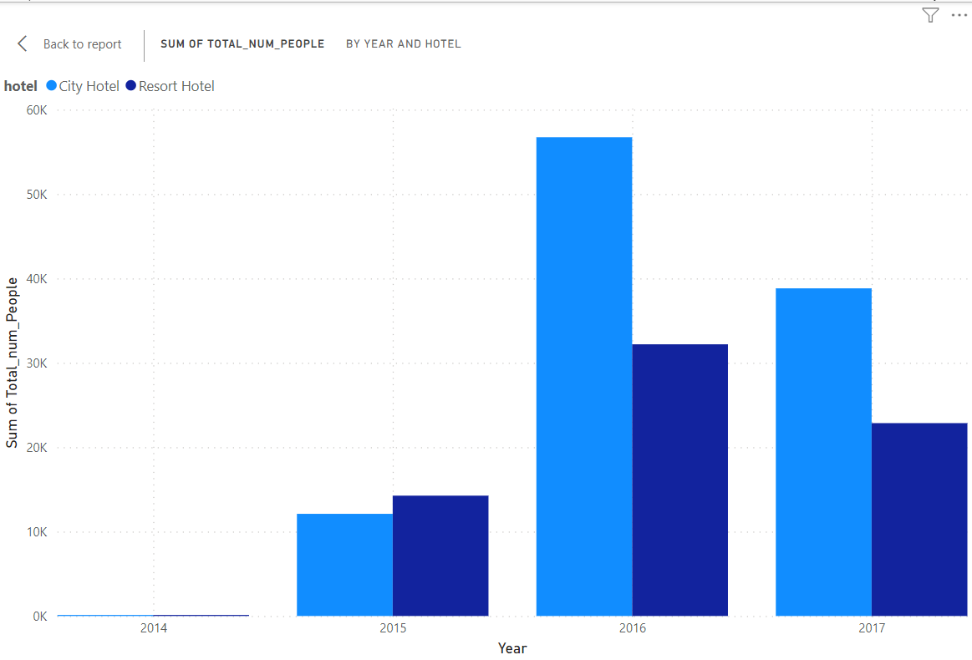
8.Which year has the maximum number of reservations?
From this chart it can be seen that the maximum number of reservations have been made in the year 2016

Slide 21
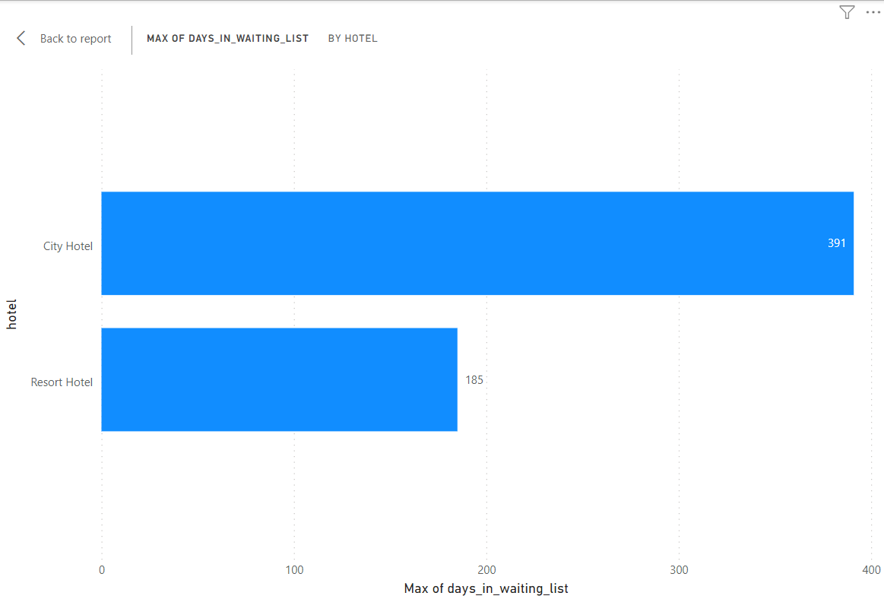
9.which hotel have higher waiting time ?
It can be seen from the chart that there is more waiting time in city hotels
so the city hoteliers will have to work for waiting time ,which will increase their booking rate

Slide 22
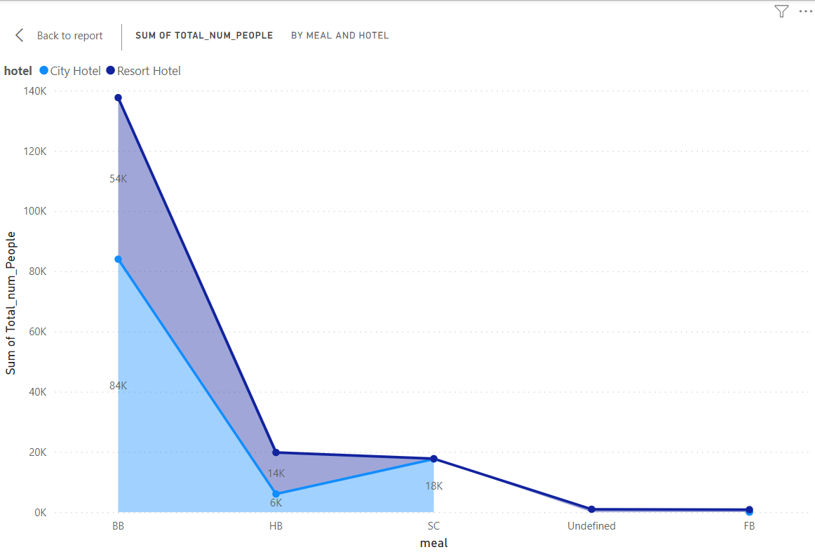
10.What kind of meal most preferred ?
From this chart it can seen that people most preferred bb meal in both hotels.
people are preferred bb meal in Resort hotels more than city hotels.
City hotels should see why their hotels bb meal are being preferred by less people than resort hotels and there should be a change in it.
Both the hotels should be seen why are many people not preferred other type of meal more.

Slide 23
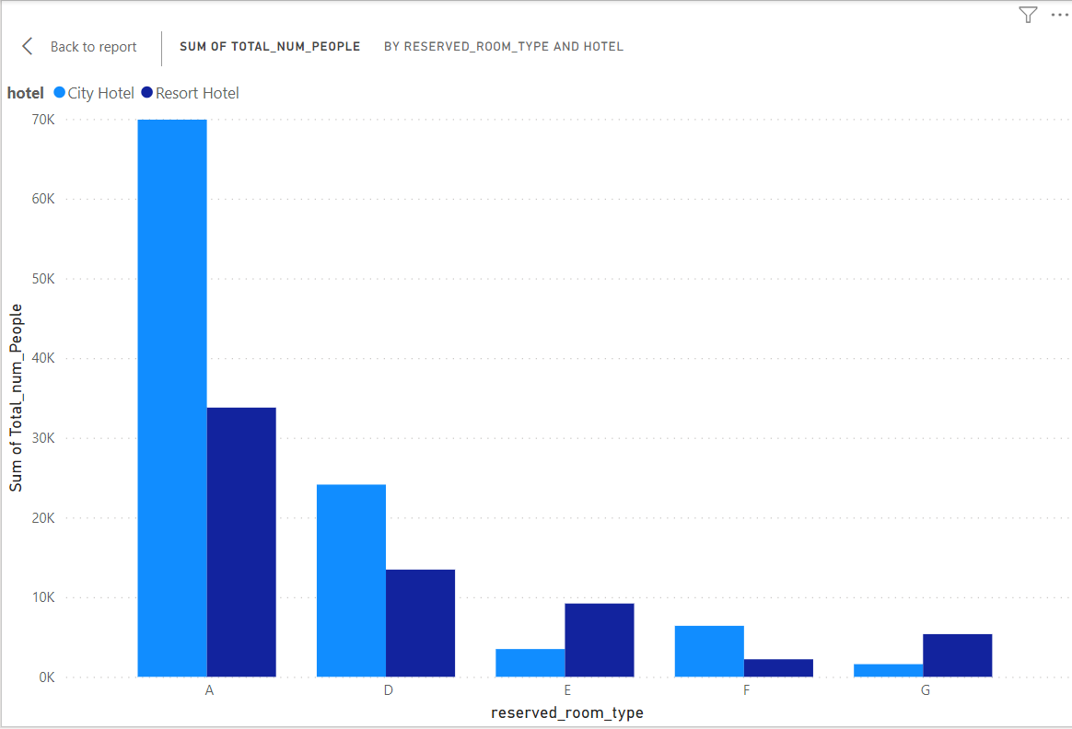
11.In which hotel which type of rooms are booked the most?
In this chart shows that most of the A type rooms are booked in both hotels.
So both hotels should increase the number of A type rooms.
It should be seen what both the hotels do so that other types of rooms are also booked more.

Slide 24
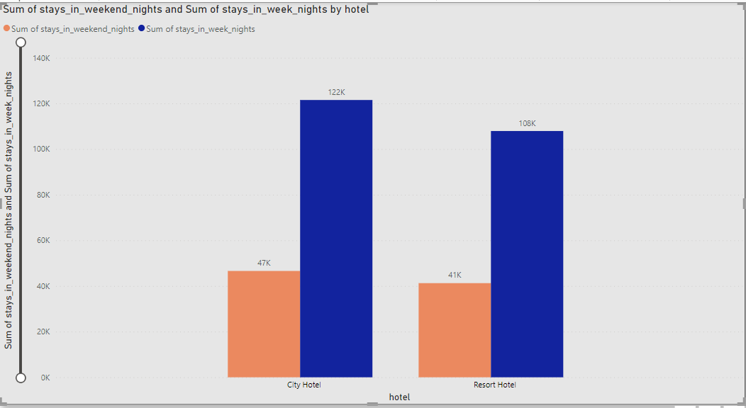
12. Find no of people stay in Weekend an week ?
From this graph it can be seen that on weekend nights maximum number of guests are stay in city hotels and on week nights also the maximum number of guests are in city hotels.
City hotel and Resort hotels should see why stay on weekend nights is decreasing compared to week night.

Slide 25
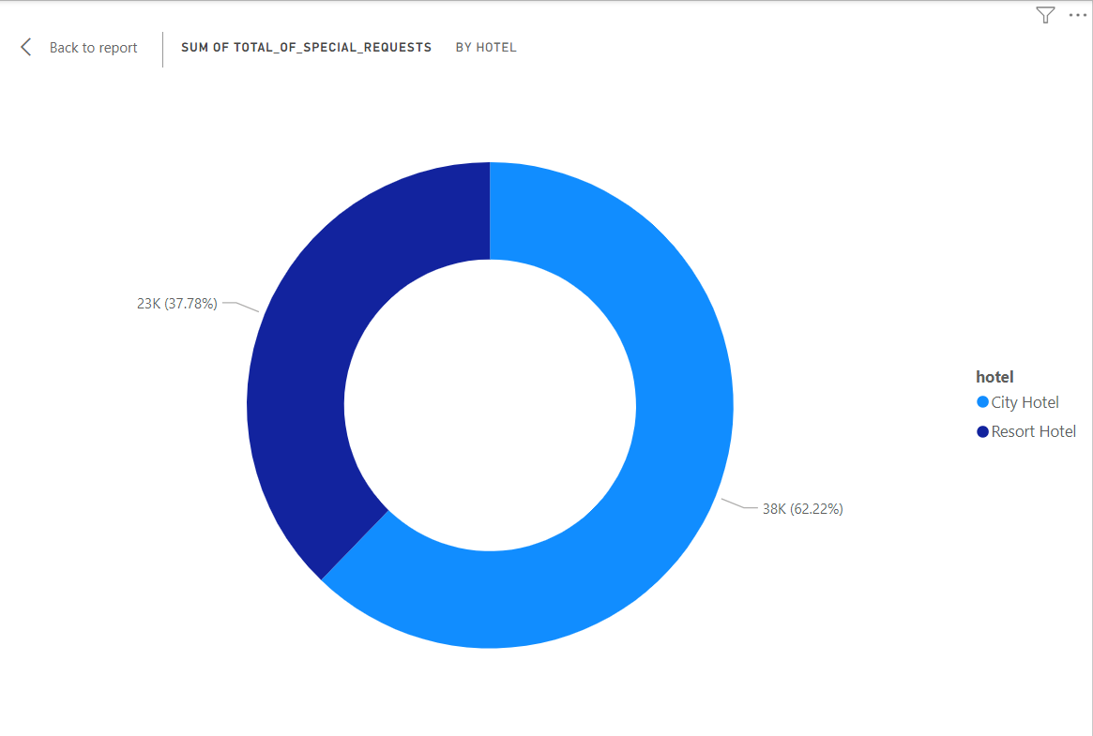
13. Which hotel has received the most special requests?
City hotels have received more special requests then resort hotels.
City hotels have received 62.22% special request and resort hotels received 37.78% special request.

Slide 26
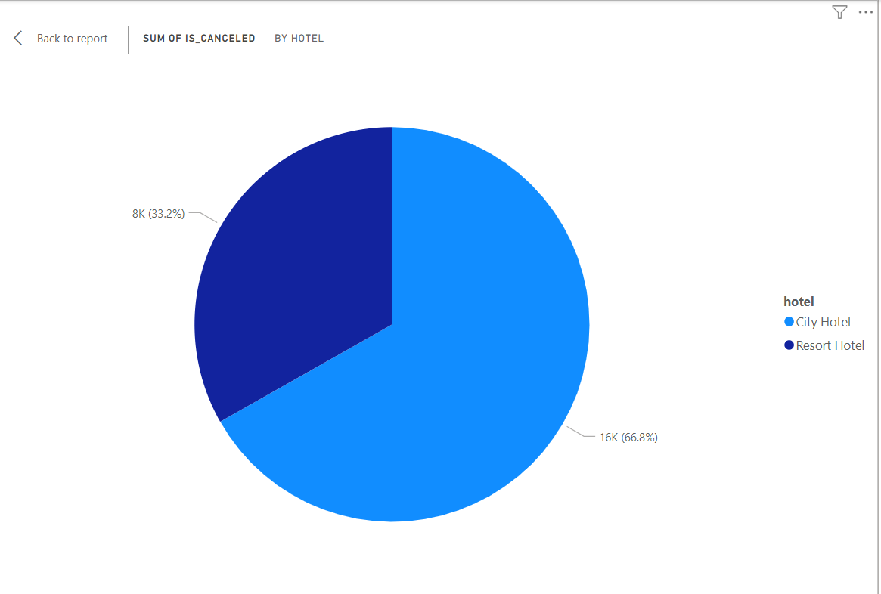
14. Which hotel has the most booking cancelled ?
It appears from the chart that most of the bookings have been cancelled at city hotel.
66.8% booking in city hotel has been cancelled or 33.2% booking in resort hotel has been cancelled.
City hotel should see what is happening due to which so many booking are being cancelled.

Slide 27
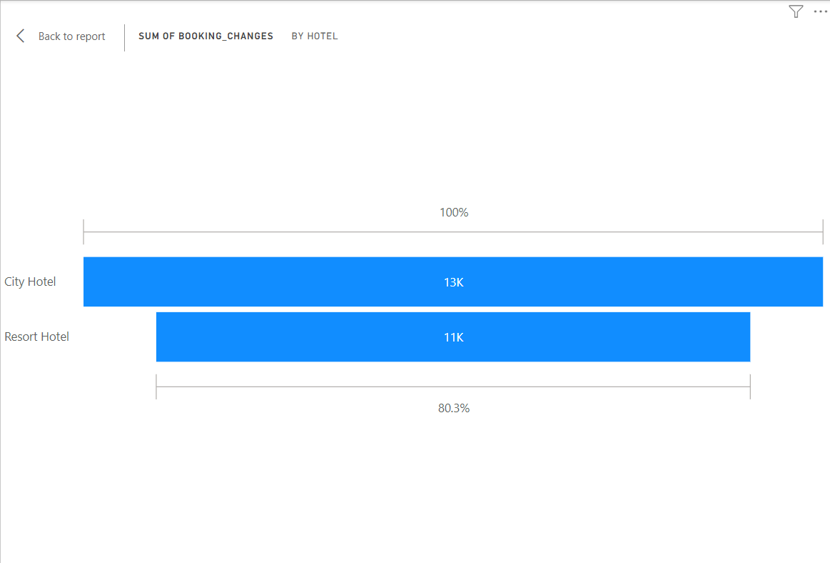
15. Which hotel has seen the most booking changes?
From this graph it can be seen that maximum booking has been done in change city hotel.
City hotels should see which facilities are not being provided by many , due to which most of the bookings are changing.

Slide 28
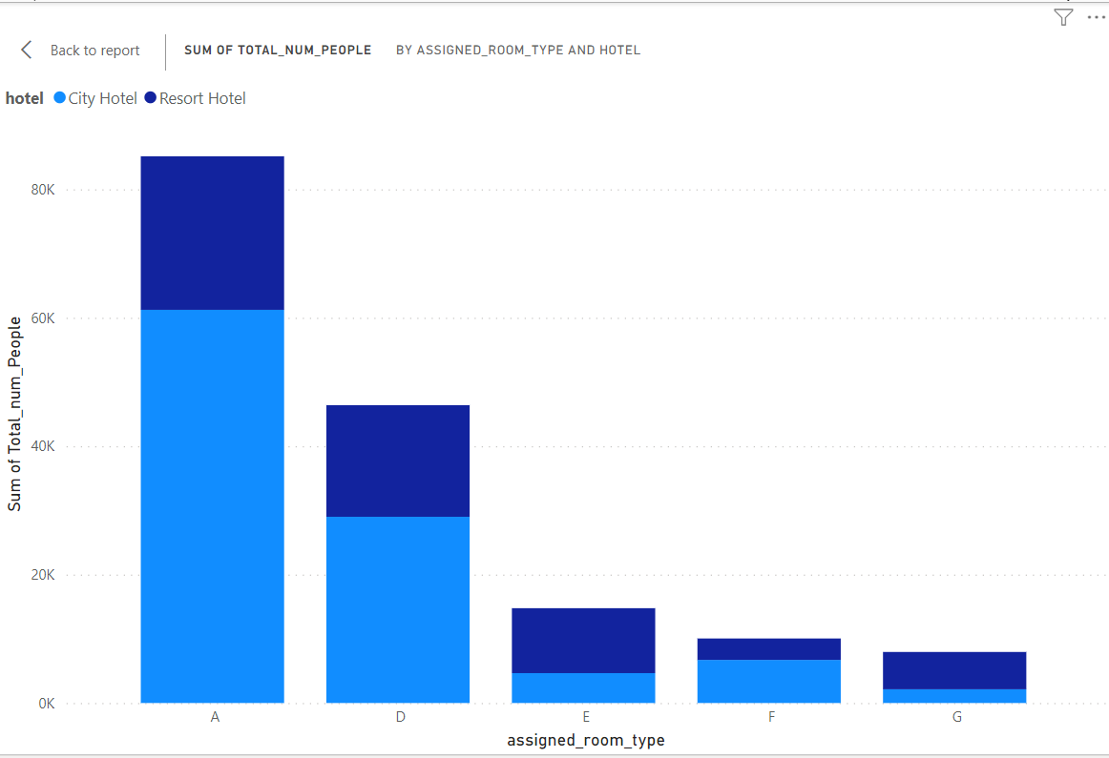
16. Which type of room most assign by both hotels ?
In this chart shows that most of the A type and D type rooms are assign in both hotels.
So both hotels should increase the number of A type rooms and D type rooms.
It should be seen what both the hotels do so that other types of rooms are also assign more.

Slide 29
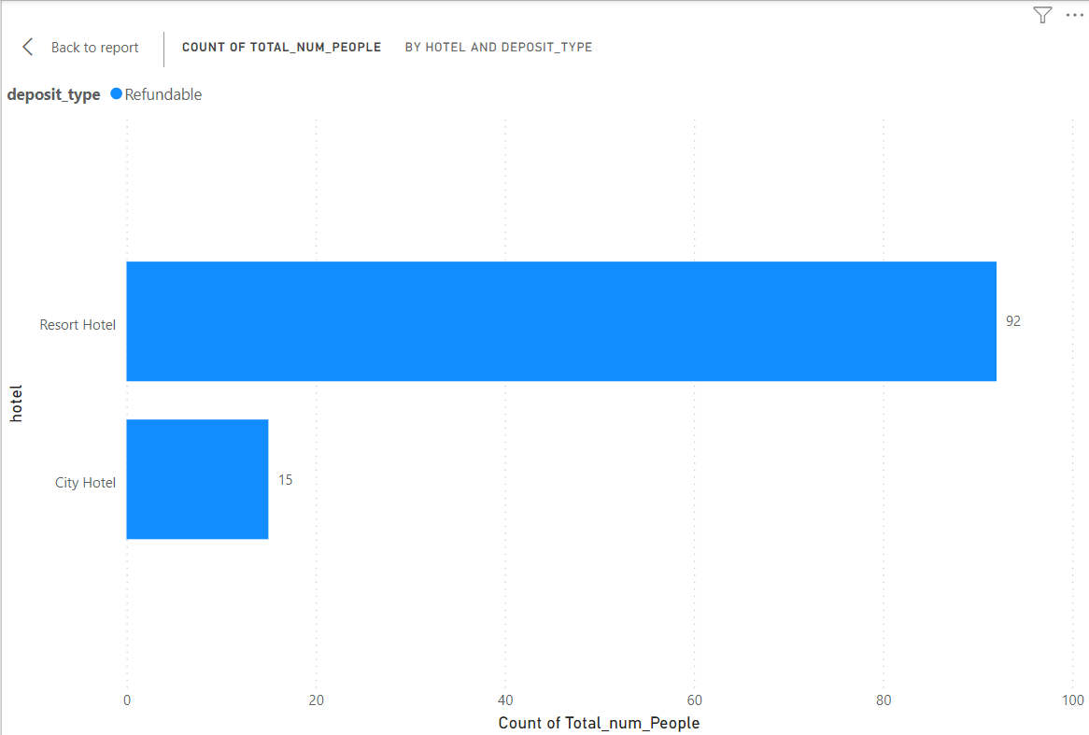
17. Which hotels give maximum refunds on canceled bookings?
From this chart it can be seen that the highest number of cancelled booking have been given by refunds resort hotel.
Resort hotel owners should see what is happening due to which bookings are being cancelled and refunds are being given.

Slide 30
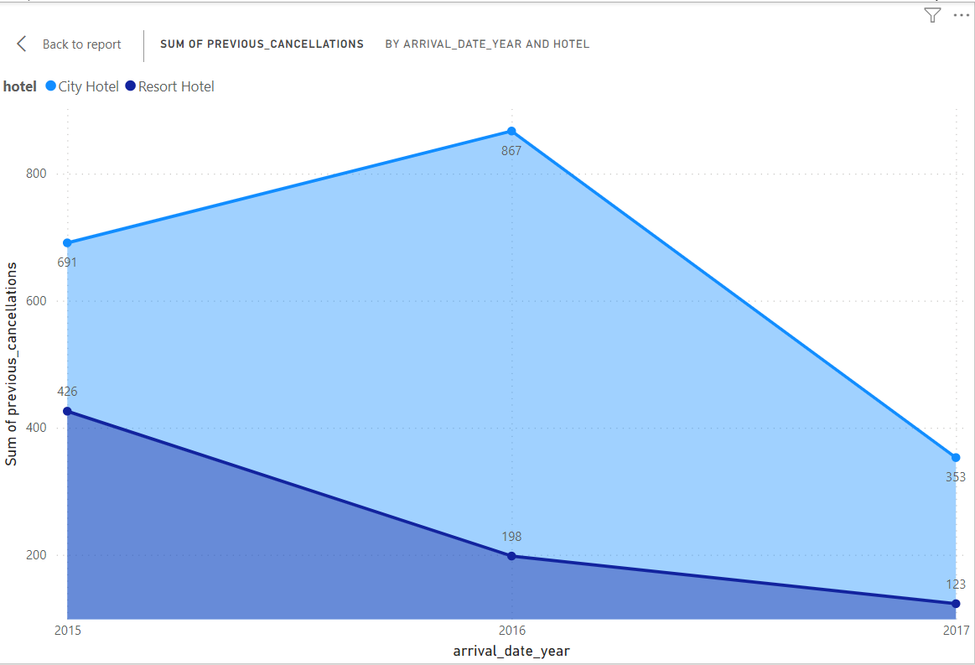
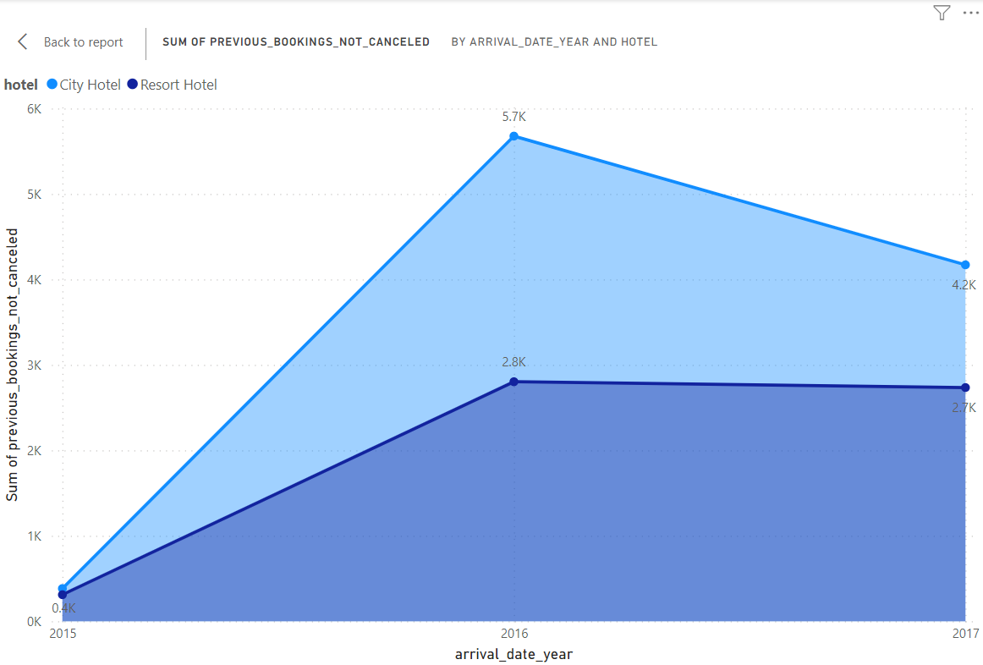
18. Which year have most previous booking canceled or not canceled?
The maximum number of previous bookings cancelled in city hotels was in the year 2016 and the maximum number of previous bookings cancelled in resort hotel was in year 2015.
The lowest number of previous bookings for both hotels has not been cancelled in year 2016.
Both the hotels should see why the previous booking is being cancelled and work on it.

Slide 31
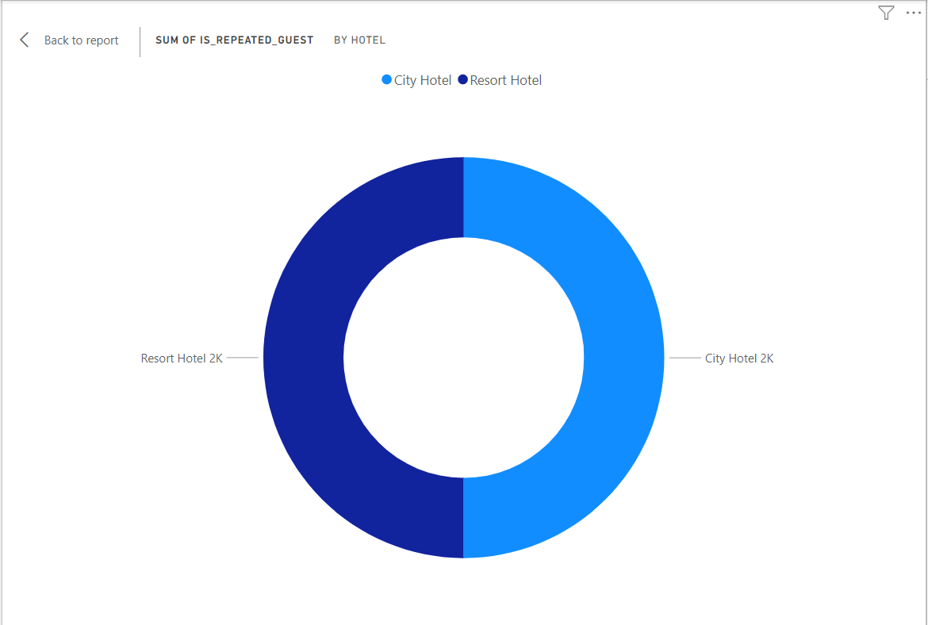
19. Which hotel has received the most repeated guests?
Both hotels all most same number of guests repeated.
Both the hotels should see what they can do so that more guests are repeated.

Slide 32
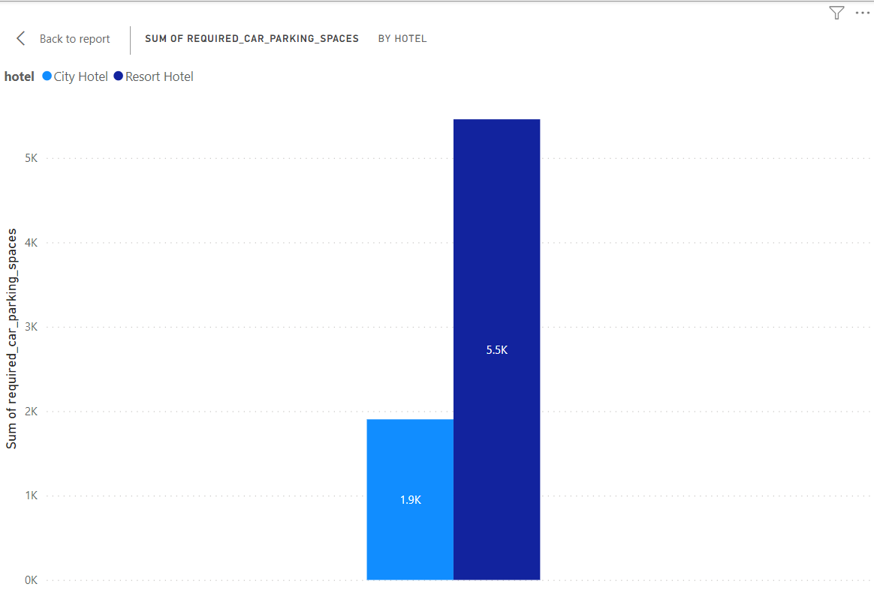
20. Which Hotel need more car parking spaces ?
From this graph it appears that resort hotels require more car parking than city hotels.
So the resort hotel should increase the car parking space so that the business of the resort hotel increases.

Slide 33
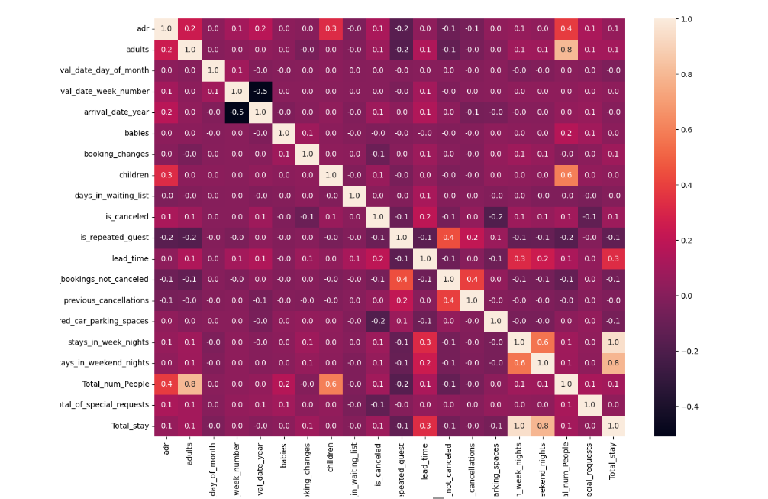
Correlation Heatmap

Slide 34
Business Objective
From all the above visualization chart it is clear that the booking rate of resort hotel is less than that of city hotel.
From the entire chart we can say that city hotels are booked more than resort hotels , which means people prefer city hotels more
Resort hotel owners need to improve their businesses a bit.
Resort hotel owners will have to see what facilities are provided by city hotels due to which their booking rate is higher than that of resort hotels.
After doing this complete visualization ,it becomes clear that the city can fulfil the customers needs and provide more facilities to the hoteliers to grow their business
From the above chart , we can see that the request for car parking space near resort hotels is more than that city hotels.
Resort hotel people need car parking spaces if they want to grow their business.
More and more people are preferring city hotels foods compare to resort hotel.
So the resort hotel owners will have to improve the food so that the booking rate increases.
Resort hotel owners need to find the best new offers so that their business increases

Slide 35


Slide 36


